Slide 1
Portfolio Optimization with Monte Carlo Simulations
By: Donya Ahmadi

Slide 2
Purpose Of Project & Project Details
The objective of this project is to optimize one's portfolio using Monte Carlo Simulations and Scipy Optimization Algorithms and historical data from Alpacas spanning the past 20 years (11/2003 - 11/2023).
More specifically, this project assists in getting the optimal asset allocation (or optimal weight) by determining the optimal sharpe ratio to maximize their portfolio and potentially beat the S&P 500.

Slide 3
Project Steps

Slide 4
Part 1 - Data (Collection, CleanUp, Display, Etc.)
The first part included importing necessary libraries, initializing variables (including env), and importing historical data using Alpacas API. The variables created were initial investment, stock tickers, start date and end date of the historical data, and number of simulations. While these are hard coded, ideally you can customize them. For the sake of my project,
My initial investment was $1,000
My chosen stock tickers were Apple, Amazon, and Microsoft
My number of simulations was 50

Slide 5
Part 2 - Monte Carlo Simulations
A Monte Carlo simulation is a computational technique that uses random sampling to model and analyze complex systems or processes. I run 50 Monte Carlo simulations to optimize a portfolio's asset allocation based on historical stock data, aiming to maximize the Sharpe ratio. The results include optimal weights for each stock, the cumulative returns of the optimized portfolio, and a benchmark (S&P 500).
To be more specific, through each iteration, the simulation tries to guess optimal weights of the chosen stocks. After all the simulations, it chooses the weights with the highest sharpe ratio (optimization).

Slide 6
Part 3 - Portfolio Optimization
Portfolio optimization is a financial modeling technique that selects the optimal mix of assets to achieve a specific investment goal. The primary objective of portfolio optimization is to maximize returns, minimize risk, or achieve a trade-off between the two, given certain constraints. This section is an analysis of the Monte Carlo results. However, the purpose of this section is to analyze and compare the performance of the portfolio with the average weights obtained from the Monte Carlo simulations against a uniform portfolio with equal weights.
Again, to be more specific, we are choosing the optimal weights simulation with the highest sharpe ratio. We do this with the Scipy optimization algorithm. The weights of all the tickers have to sum to 1 and have to be between 0 and 1.

Slide 7
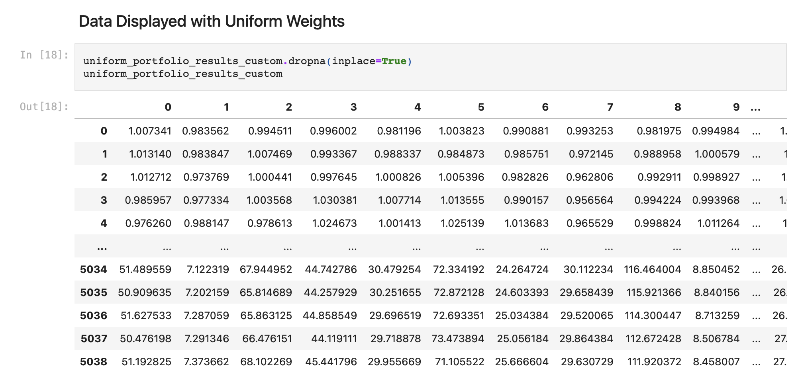
Part 4 - Data Visualization

Slide 8
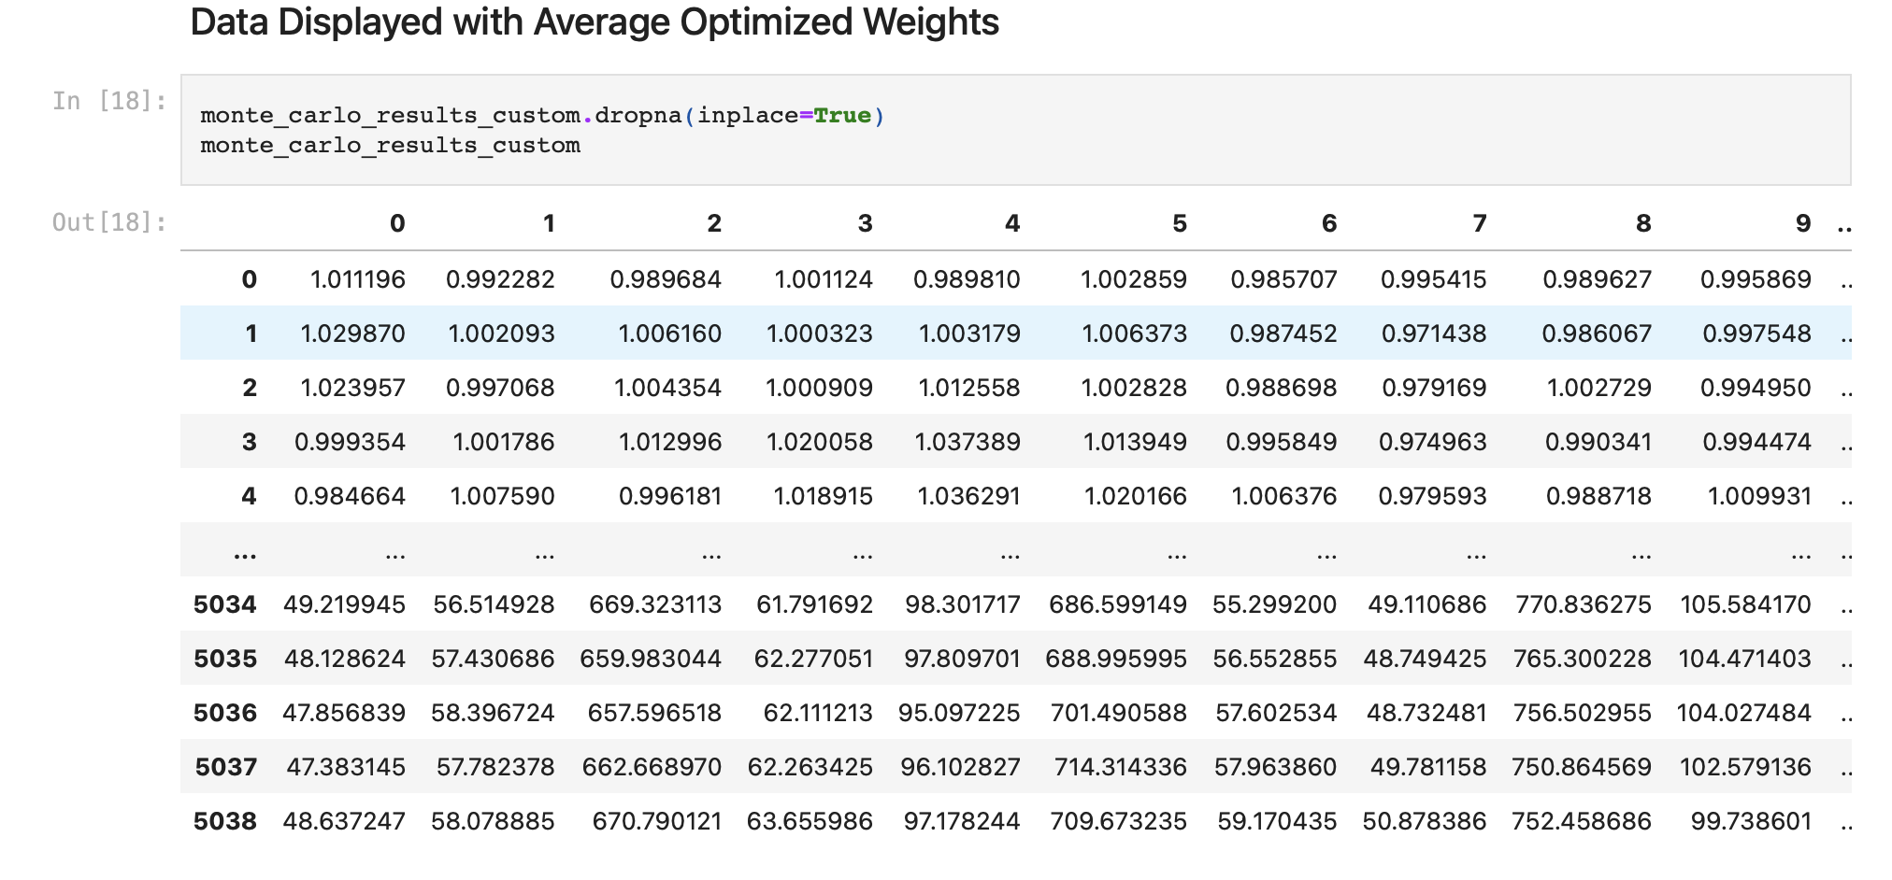

Slide 9
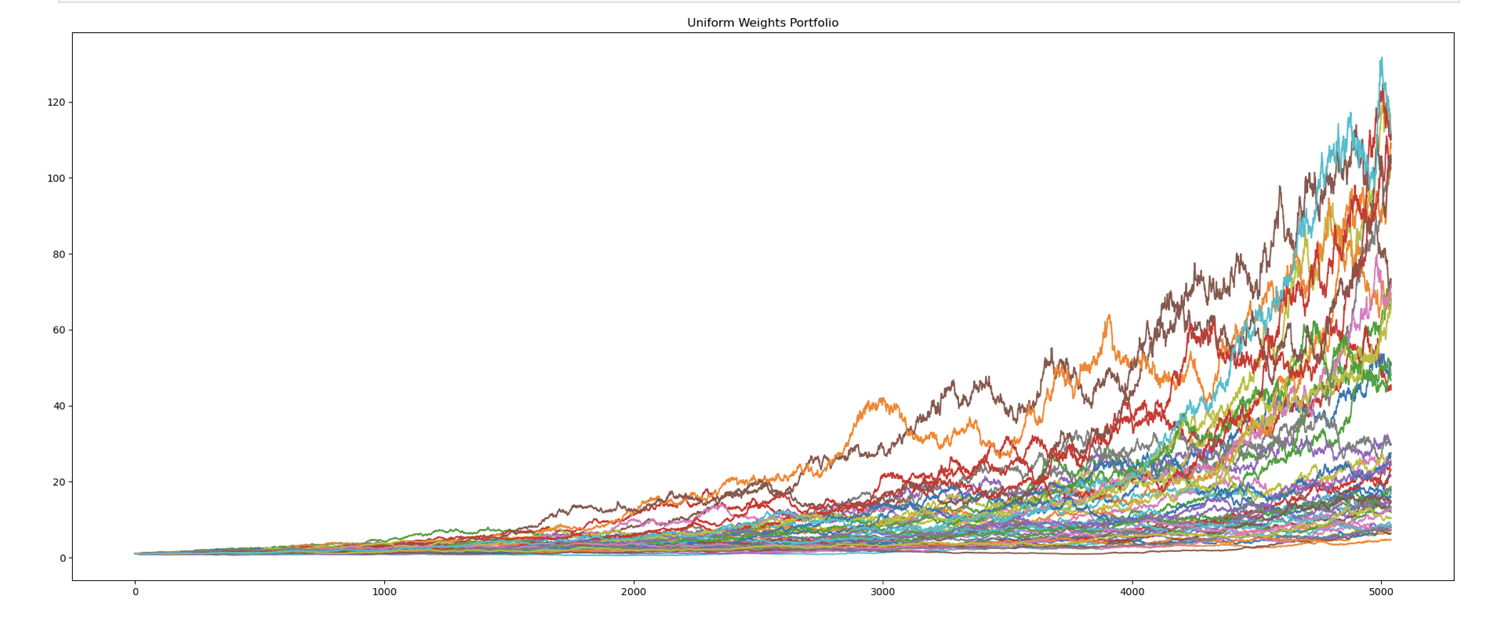
Uniform Weights Portfolio Return

Slide 10
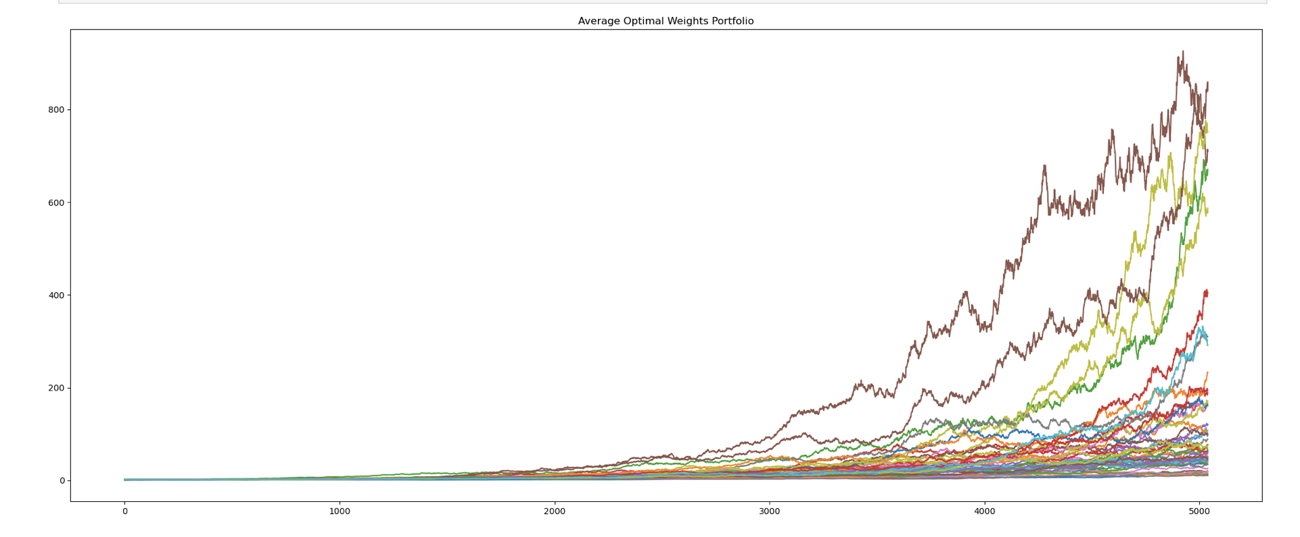
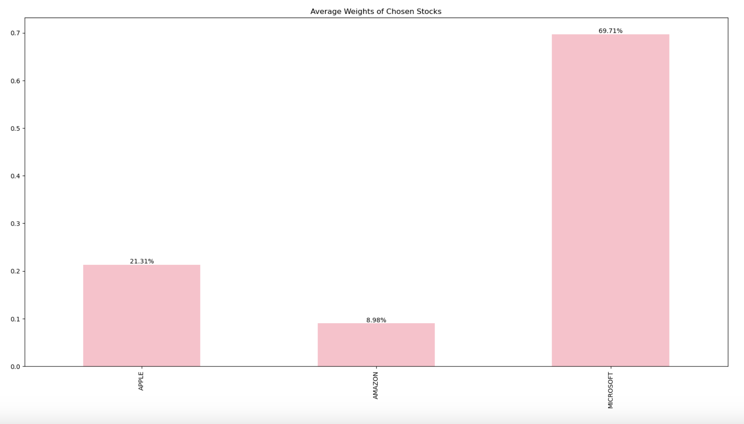
Average Optimized Weights Return

Slide 11
Uniform Weights:
Average Optimized Weights:

Slide 12
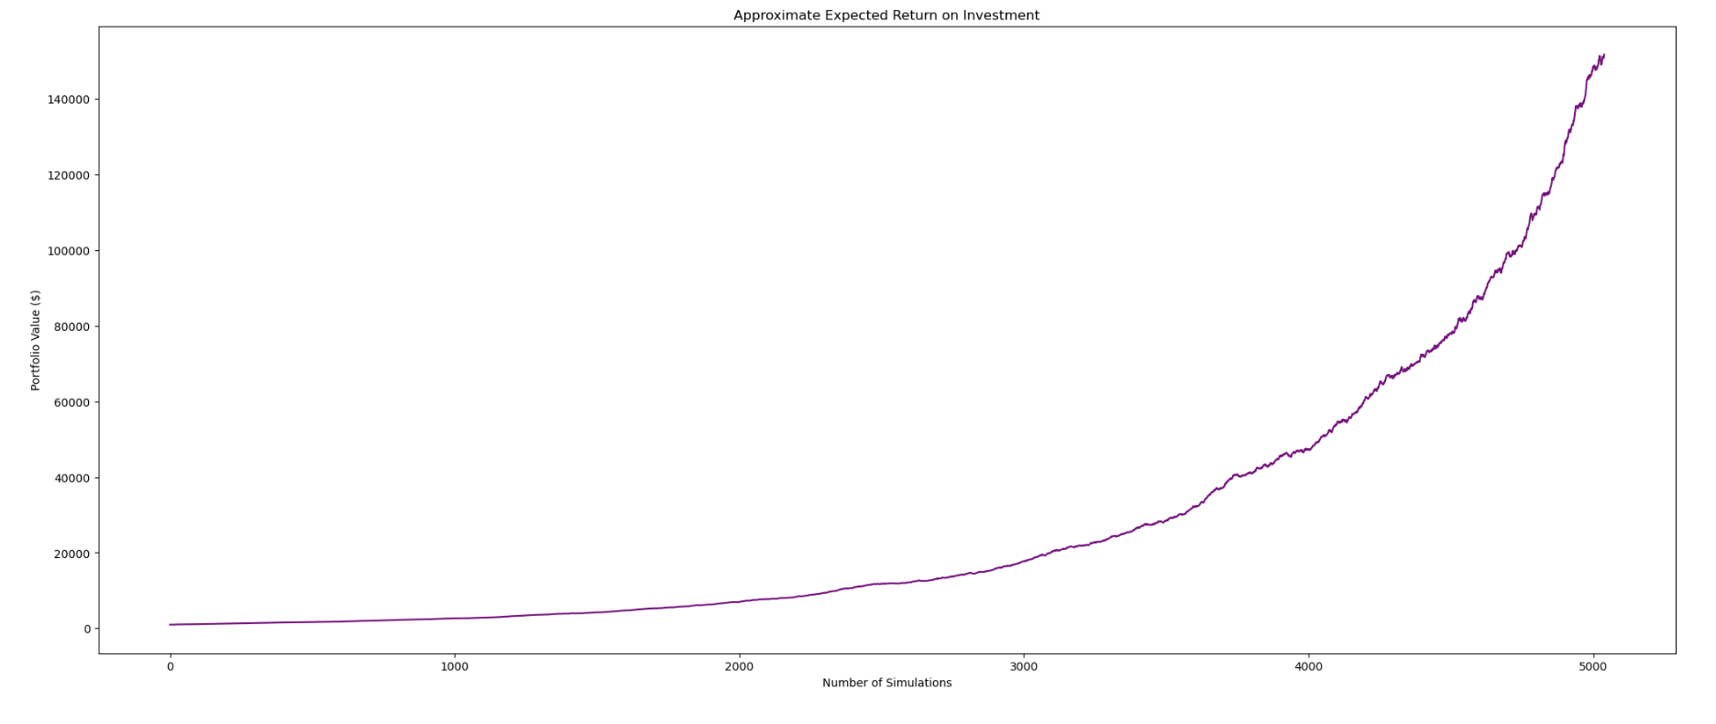
Expected Return on Investment (Optimized)

Slide 13
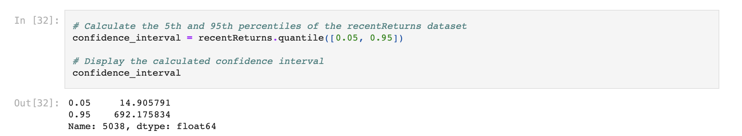
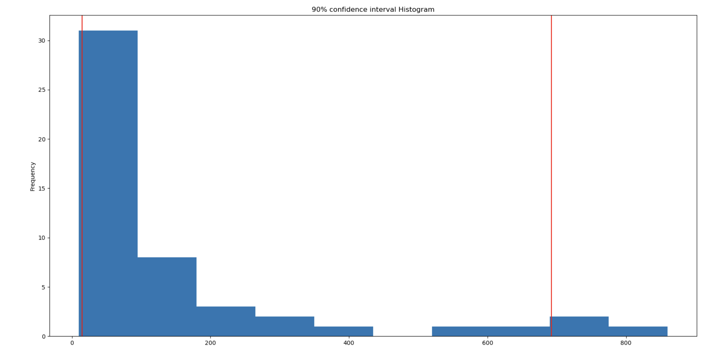
Confidence Interval
The 90% confidence interval for the values in the optimized weights dataset is approximately [14.91, 692.18]. This means that there is a 90% confidence that the true values lie within this range

Slide 14
Conclusions & Next Steps
After comparing the results of optimized weights versus uniform weights, it is evident the Monte Carlo simulations have been successful. You can see this in the above plots and statements. I think Monte Carlo simulations and Scipy optimization are great tools for for portfolio optimization analysis. In addition, it shows how important stock weight is as well to maximize return.
Regarding limitations, Some limitations include the volatility of the stock market so it can be difficult to predict it with the current day's technology. I believe some next steps would include creating this project with a recurrent neural network and comparing predictions.

